Slide 1


HEP NTUA Weekly Report 27/1/2021
George Bakas

Slide 2
Summary
TTbar analysis:
BLUE method
Implemented the method to check how the software works
Created pipeline to switch to UL files
Production, several problems
2016 is divided into preVFP and post VFP
All years have UL 19 and UL 20 files: which should we use? Some files only with UL19 some only with UL20 and some on both!
After production → training
Re-do the whole pipeline of the analysis
Efficiency, Acceptance, Responses
Mass Fit, Ryield, Contamination, Closure Tests
Signal Extraction
Unfolding
---------------------
Systematics
---------------------
Combination

Slide 3
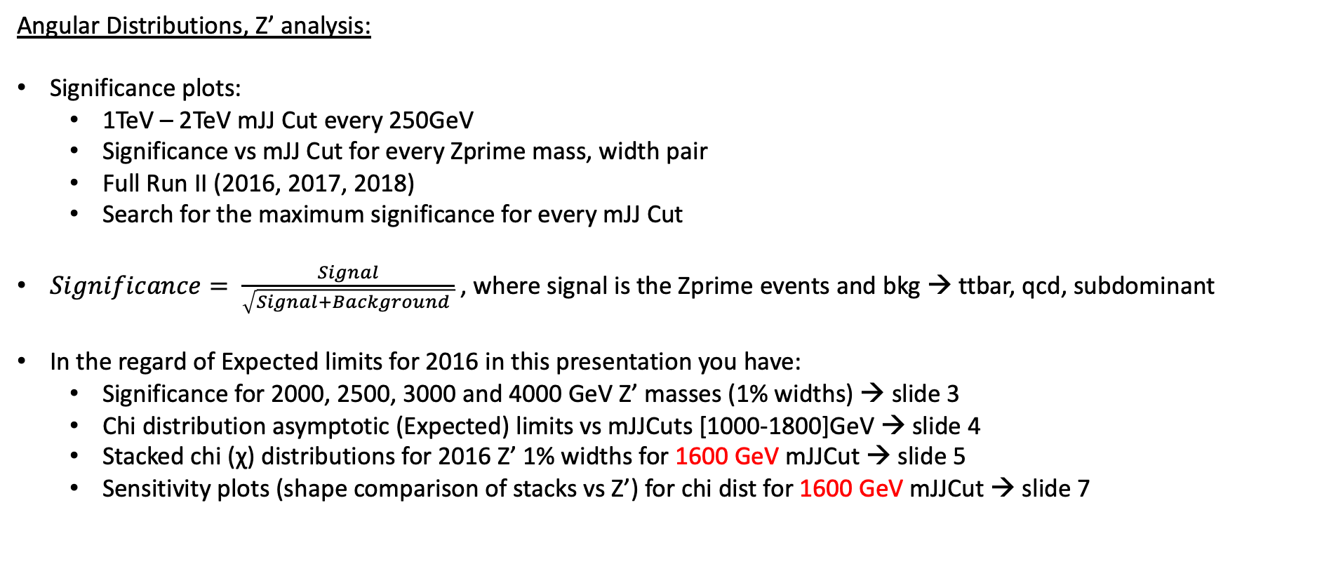
Summary
Angular Distributions, Z’ analysis:
Significance plots:
1TeV – 2TeV mJJ Cut every 250GeV
Significance vs mJJ Cut for every Zprime mass, width pair
Full Run II (2016, 2017, 2018)
Search for the maximum significance for every mJJ Cut
$Significance= \frac{Signal}{\sqrt{Signal+Background }}$, where signal is the Zprime events and bkg → ttbar, qcd, subdominant
In the regard of Expected limits for 2016 in this presentation you have:
Significance for 2000, 2500, 3000 and 4000 GeV Z’ masses (1% widths) → slide 3
Chi distribution asymptotic (Expected) limits vs mJJCuts [1000-1800]GeV → slide 4
Stacked chi (χ) distributions for 2016 Z’ 1% widths for 1600 GeV mJJCut → slide 5
Sensitivity plots (shape comparison of stacks vs Z’) for chi dist for 1600 GeV mJJCut → slide 7

Slide 4
Significance Plots 2016, width 1%

Slide 5
Expected Limit Plots 2016, width 1%

Slide 6
Stack Plots 2016, width 1%
M: 2TeV
M: 2.5TeV
M: 3TeV
M: 4TeV

Slide 7
Stack Plots 2016, width 10%
M: 2TeV
M: 2.5TeV
M: 3TeV
M: 4TeV

Slide 8
Stack Plots 2016, width 1% (Z’ hist incorporated in Stack)
M: 2TeV
M: 2.5TeV
M: 3TeV
M: 4TeV

Slide 9
Stack Plots 2016, width 10% (Z’ hist incorporated in Stack)
M: 2TeV
M: 2.5TeV
M: 3TeV
M: 4TeV

Slide 10
Sensitivity Plots 2016, width 1%
M: 2TeV
M: 2.5TeV
M: 3TeV
M: 4TeV

Slide 11
Sensitivity Plots 2016, width 10%
M: 2TeV
M: 2.5TeV
M: 3TeV
M: 4TeV

Slide 12
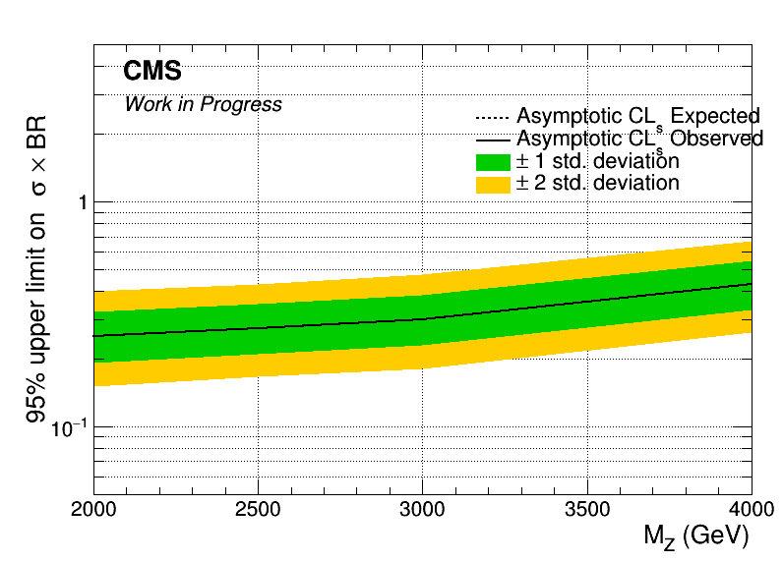
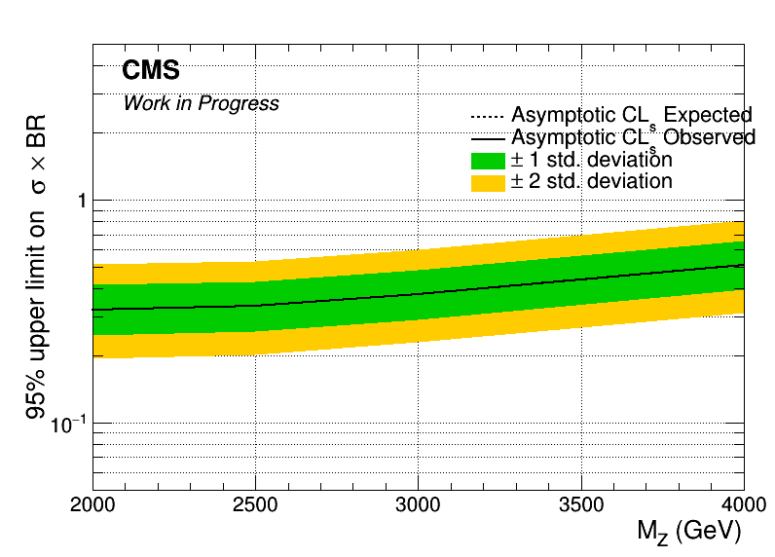
Brazilian Plots 2016, width 1%, 10%
Width: 1%
Width: 10%

Slide 13
BACKUP

Slide 14
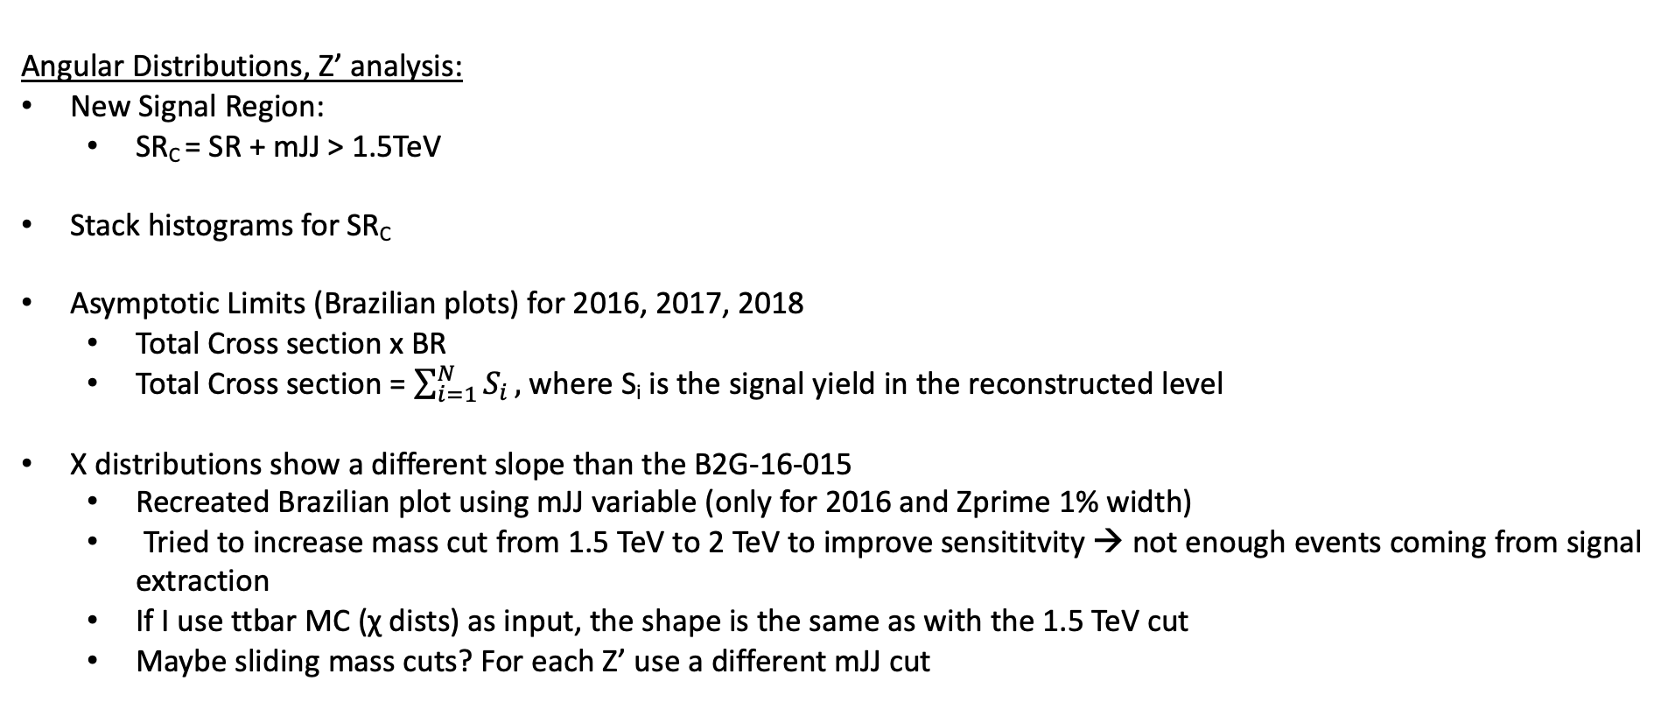
Summary
Angular Distributions, Z’ analysis:
New Signal Region:
SR_{C} = SR + mJJ > 1.5TeV
Stack histograms for SR_{C}
Asymptotic Limits (Brazilian plots) for 2016, 2017, 2018
Total Cross section x BR
Total Cross section = $\sum_{i=1}^{N}{S_{i}},$where S_{i} is the signal yield in the reconstructed level
Χ distributions show a different slope than the B2G-16-015
Recreated Brazilian plot using mJJ variable (only for 2016 and Zprime 1% width)
Tried to increase mass cut from 1.5 TeV to 2 TeV to improve sensititvity → not enough events coming from signal extraction
If I use ttbar MC (χ dists) as input, the shape is the same as with the 1.5 TeV cut
Maybe sliding mass cuts? For each Z’ use a different mJJ cut

Slide 15
Signal Selection
Control Region Selection
Variables | Selected Cut
pT (both leading jets) | > 400 GeV
Njets | > 1
N leptons | = 0
|eta| (both leading jets) | < 2.4
mJJ | > 1000 GeV
jetMassSoftDrop (only for fit) | (50,300) GeV
Top Tagger | > 0.2, 0, 0.1
B tagging (2 btagged jets) | > Medium WP
Signal Trigger
Variables | Selected Cut
pT (both leading jets) | > 400 GeV
Njets | > 1
N leptons | = 0
|eta| (both leading jets) | < 2.4
mJJ | > 1000 GeV
jetMassSoftDrop (only for fit) | (50,300) GeV
Top Tagger | > 0.2, 0, 0.1
B tagging (0 btagged jets) | < Medium WP
Control Trigger

Slide 16

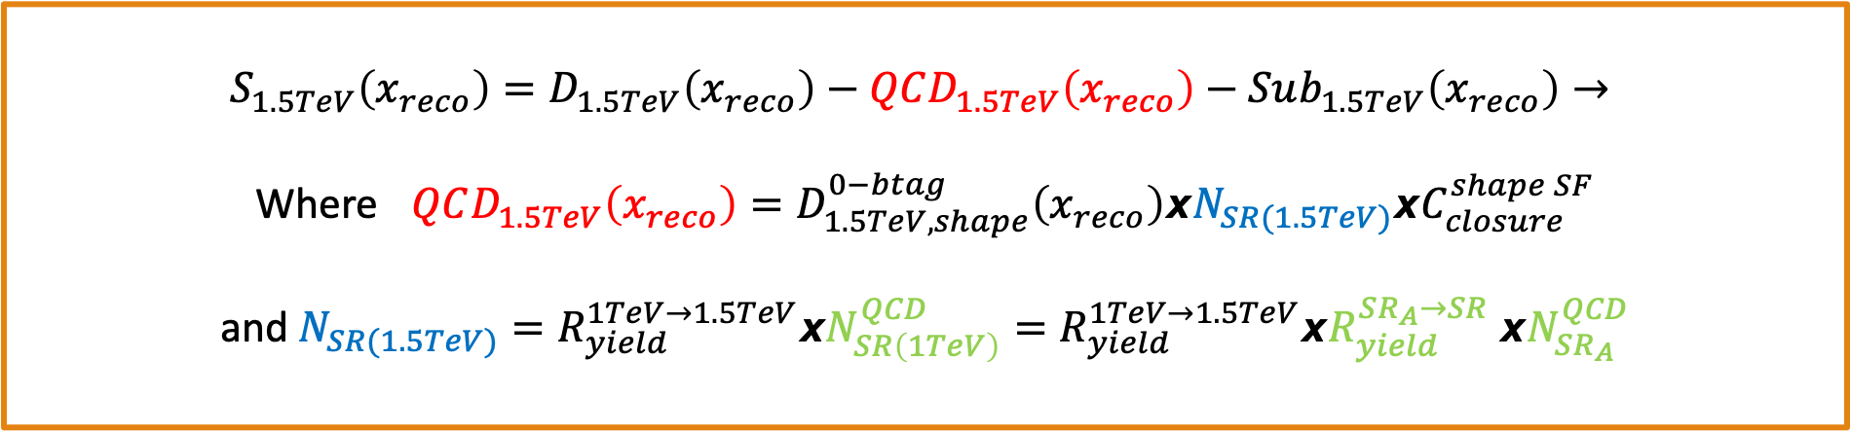

Signal Extraction
$$S_{1.5TeV}\left(x_{reco}\right)=D_{1.5TeV}\left(x_{reco}\right)−QCD_{1.5TeV}\left(x_{reco}\right)−Sub_{1.5TeV}\left(x_{reco}\right)→$$
Where $QCD_{1.5TeV}\left(x_{reco}\right)=D_{1.5TeV, shape}^{0−btag}\left(x_{reco}\right)xN_{SR(1.5TeV)}{xC}_{closure}^{shape SF}$
and $N_{SR(1.5TeV)}=R_{yield}^{1TeV→1.5TeV}xN_{SR\left(1TeV\right)}^{QCD}=R_{yield}^{1TeV→1.5TeV}xR_{yield}^{SR_{A}→SR} {xN}_{SR_{A}}^{QCD}$
The variable of interest here: x_{reco} → χ
1.5 TeV refers to the mJJ cut
We deploy a fit in the Signal Region (2btag) to extract the $N_{QCD}^{fit}$ in SRA (mJJ > 1TeV)
$$D{\left(m^{t}\right)}^{(i)}=N_{tt}^{(i)}T^{(i)}\left(m^{t},k_{MassScale}, k_{MassResolution}\right)+N_{bkg}^{(i)}B\left(m^{t} \right)\left(1+k_{1}x\right)+N_{sub}^{(i)}O^{(i)}\left(m^{t}\right)$$

Slide 17
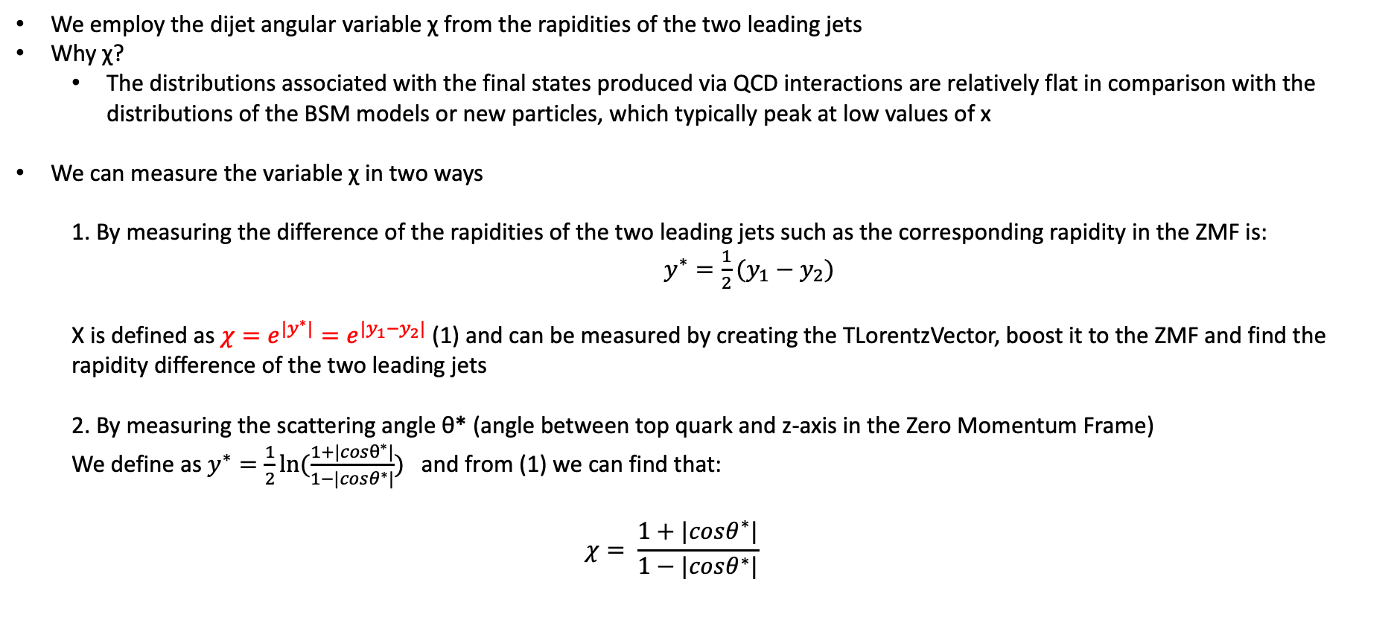
Top Angular Distributions
We employ the dijet angular variable χ from the rapidities of the two leading jets
Why χ?
The distributions associated with the final states produced via QCD interactions are relatively flat in comparison with the distributions of the BSM models or new particles, which typically peak at low values of x
We can measure the variable χ in two ways
1. By measuring the difference of the rapidities of the two leading jets such as the corresponding rapidity in the ZMF is: $y^{∗}=\frac{1}{2}(y_{1}−y_{2})$
Χ is defined as $χ=e^{{|y}^{∗}|}=e^{|y_{1}−y_{2}|}$ (1) and can be measured by creating the TLorentzVector, boost it to the ZMF and find the rapidity difference of the two leading jets
2. By measuring the scattering angle θ* (angle between top quark and z-axis in the Zero Momentum Frame)
We define as $y^{∗}=\frac{1}{2}ln⁡(\frac{1+|cosθ^{∗}|}{1−|cosθ^{∗}|})$ and from (1) we can find that:
$$χ= \frac{1+|cosθ^{∗}|}{1−|cosθ^{∗}|}$$

Slide 18
Stack Distributions vs B2G-16-015 Mz=2TeV, w 1%
2016
2018
2017

Slide 19
Stack Distributions vs B2G-16-015 Mz=2TeV, w 10%
2016
2018
2017

Slide 20
Stack Distributions Mz = 2.5TeV, w 1%
2016
2018
2017

